Slide 1

EpiSure Seizure Prediction Team 1 Sprint 4
By: Rashmi, Matthew, Shruti 12 Dec, 2016
GitHub Link

Slide 2
Product Highlights
Successfully developed a system to predict epileptic seizures using EEG recordings; treating the recordings as real time EEG data of an epileptic patient
Developed an efficient app to provide notification to the patient and an emergency contact during the seizure stages
Data
Processing
Database
App
Notification

Slide 3
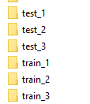
Product Highlights Detailed: Model Generation
EEG Data
Processing Unit
Feature Extraction Code
Generate Model
Generate Confusion matrices:
Original 0.5 threshold
Additional 0.5 threshold
Additional 0.4 threshold
70%
Cross validate
Trained Model
30%

Slide 4
Product Highlights Detailed: Final Product
EEG Data
Processing Unit
Feature Extraction Code
Compare to Trained Model
100%
Database
Prediction
App
Notification

Slide 5
Confusion Matrices
 | Comparison of calculated features to model generates number between 0 and 1
 | 0.5 Threshold
 | Pred. 0 | Pred. 1 |  | Pred. 0 | Pred. 1 |  | Pred. 0 | Pred. 1
True 0 | 1151 | 1 |  | 2195 | 1 |  | 2225 | 19
True 1 | 150 | 0 |  | 145 | 5 |  | 116 | 34
Accuracy | 0.884 |  |  | 0.938 |  |  | 0.944
 | Comparison of calculated features to model generates number between 0 and 1
 | 0.4 Threshold
 | Pred. 0 | Pred. 1 |  | Pred. 0 | Pred. 1 |  | Pred. 0 | Pred. 1
True 0 | 1151 | 1 |  | 2190 | 6 |  | 2206 | 38
True 1 | 149 | 1 |  | 144 | 6 |  | 98 | 52
Accuracy | 0.885 |  |  | 0.936 |  |  | 0.943
 | Reduced Number of true zero files for training model so as to generate less biased confusion matrices
 | 0.4 Threshold
 | Pred. 0 | Pred. 1 |  | Pred. 0 | Pred. 1 |  | Pred. 0 | Pred. 1
True 0 | 229 | 21 |  | 244 | 6 |  | 248 | 2
True 1 | 53 | 97 |  | 98 | 52 |  | 6 | 144
Accuracy | 0.815 |  |  | 0.740 |  |  | 0.980

Slide 6
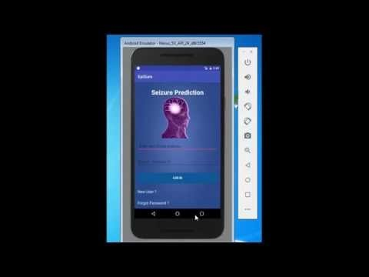
Demonstration
Link: https://www.youtube.com/watch?v=WUb-0OqpBKQ

Slide 7
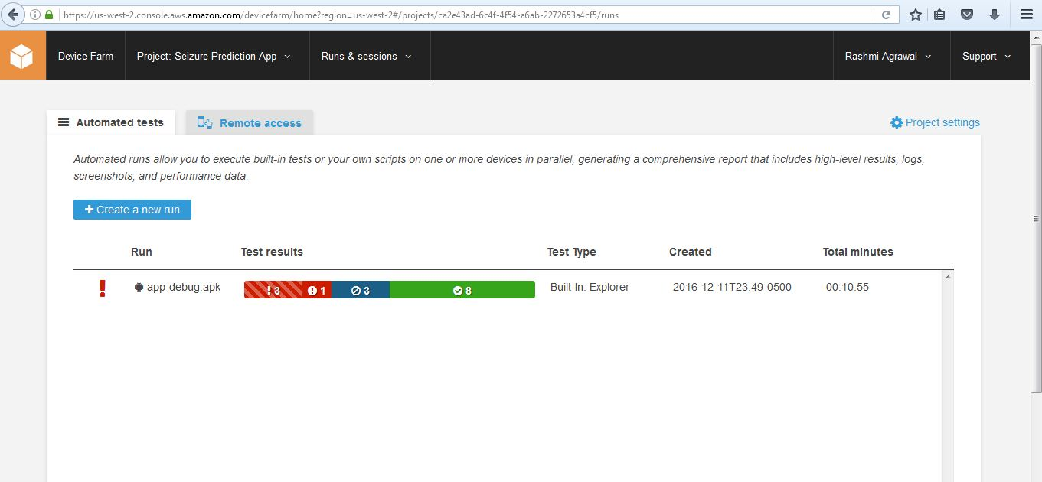
Test results: AWS

Slide 8
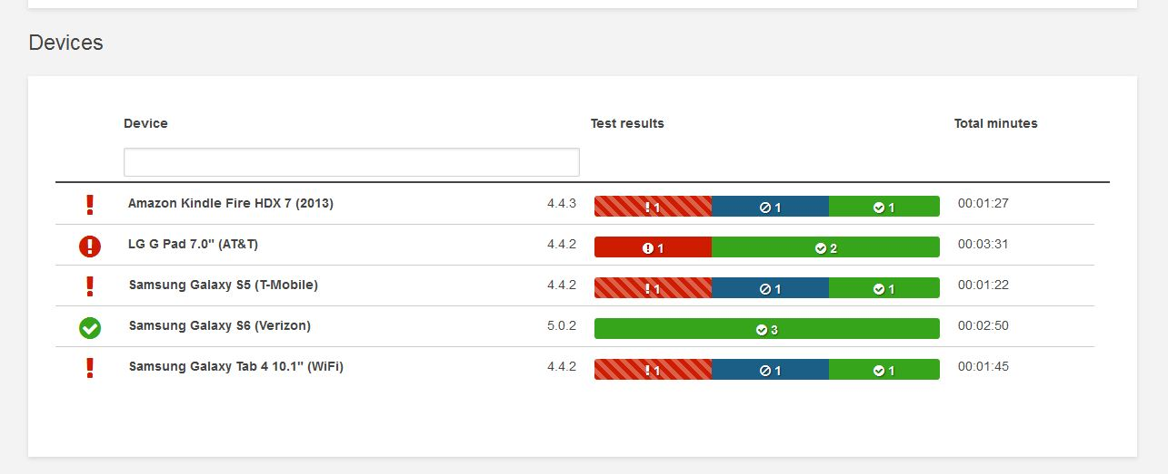
Test results: AWS

Slide 9
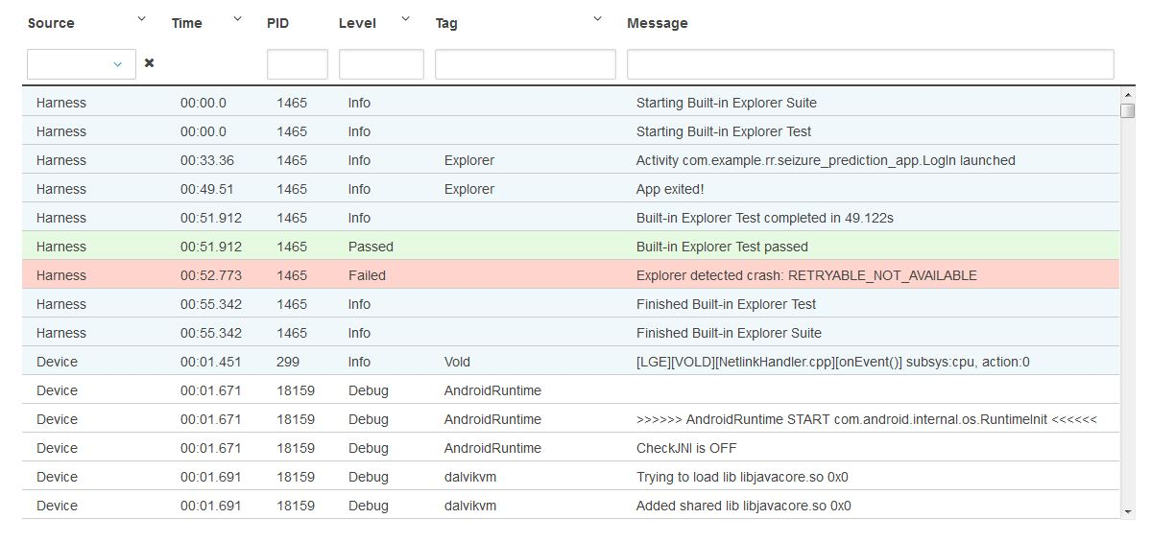
Test results: AWS

Slide 10
Lessons Learned
Top three things that worked well
Android Application
Feature Extraction, Machine Learning
Shared Computing Cluster
Top three things that you have learned
EEG Signal Characteristics
Execute Matlab Scripts on SCC
Android App Development & MATLAB to database connectivity

Slide 11
Lessons Learned
Top three things that did not go well
Neural Network
Additional EEG signal feature extraction roadblocks
Competition test data replaced near competition deadline
One thing you as a team will do differently in the future
Decide the final approach earlier
Any future plans for your project
Continue to improve prediction accuracy via additional features

Slide 12


Slide 13
Additional Slides

Slide 14
Main use cases
Epileptic Patient
To reduce persistent anxiety
To help them avoid doing potentially dangerous activities
To seek timely medical assistance
To ensure more effective use of medication
Emergency Contact
To make an emergency contact aware about the patient’s oncoming seizure
Doctor
To provide the patient with timely medical assistance, if needed

Slide 15
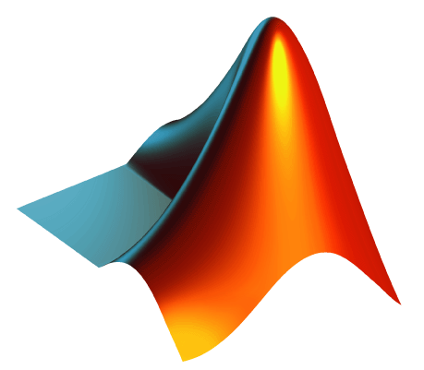




Tools
Data Processing
MATLAB
Parallel Computing Toolbox
Statistical and Machine Learning toolbox
Signal Processing Toolbox
Data Validation
BU Shared Computing Cluster
Database
SQLite
MySQL
Front End
Android Studio

Slide 16
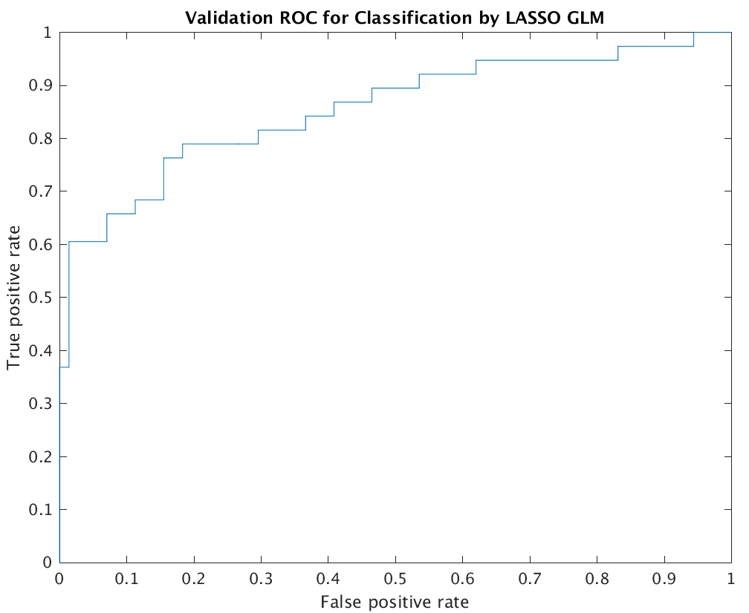
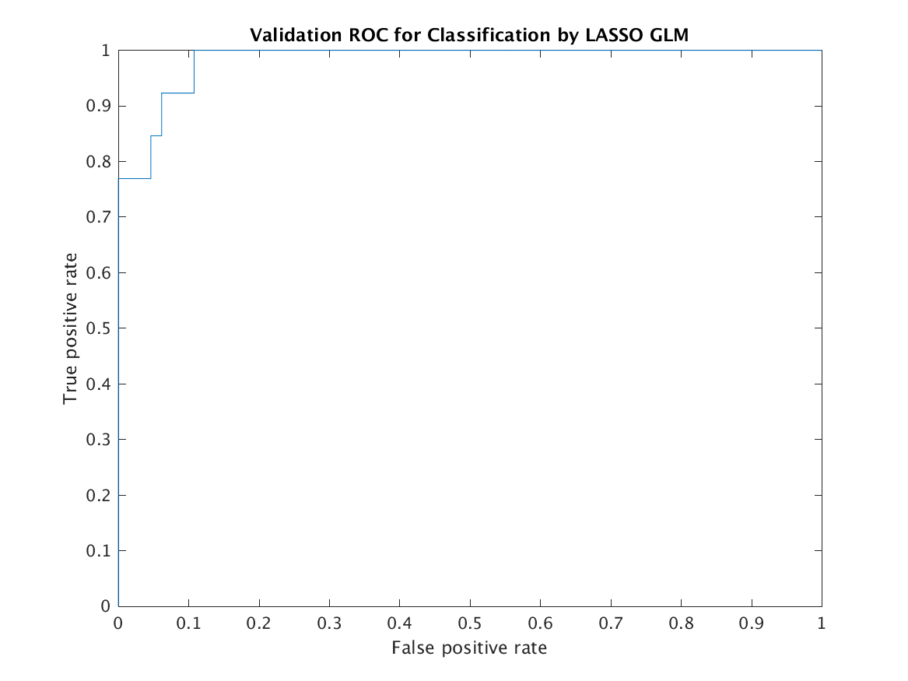
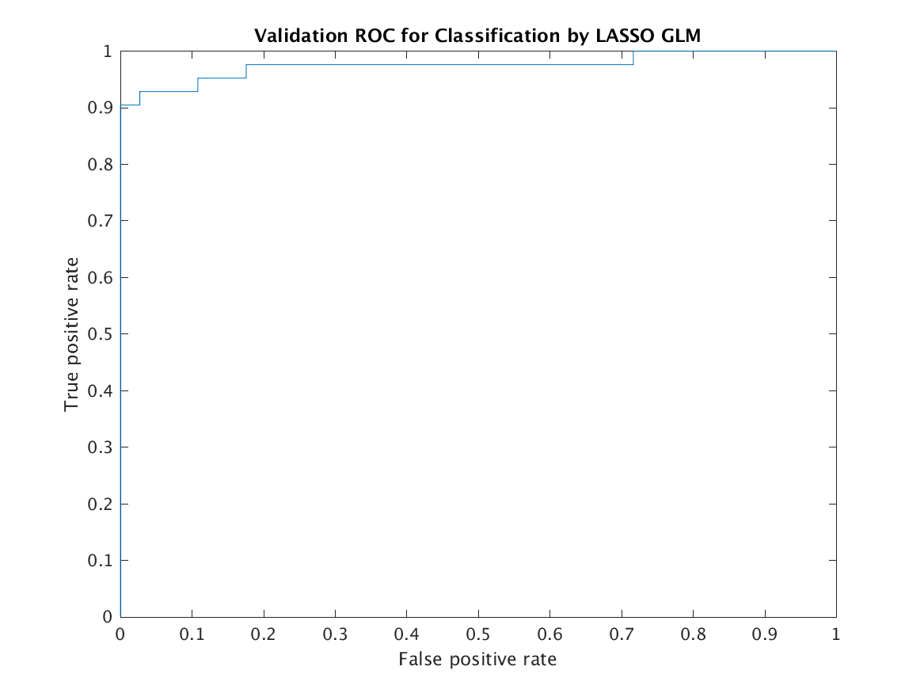
Validation ROC for Classification by LASSO GLM
Train: Patient 01
Train: Patient 02
Train: Patient 03

